Slide 3
LEVEL 300 DEEP DIVE
Battling the Assumptions
How what you think you know about Azure Networking is a lie

Slide 4
Today's Journey
1
The Foundation: How Azure Really Works
5
Myth: Routing Works Like On-Prem
2
Myth: VNets Are Like Physical Networks
6
Myth: NSGs Are Simple ACLs
3
Myth: Subnets Are Broadcast Domains
7
The VFP Deep Dive
4
Myth: ARP and DHCP Work Normally
8
Accelerated Networking & SR-IOV
45 minutes

Slide 5
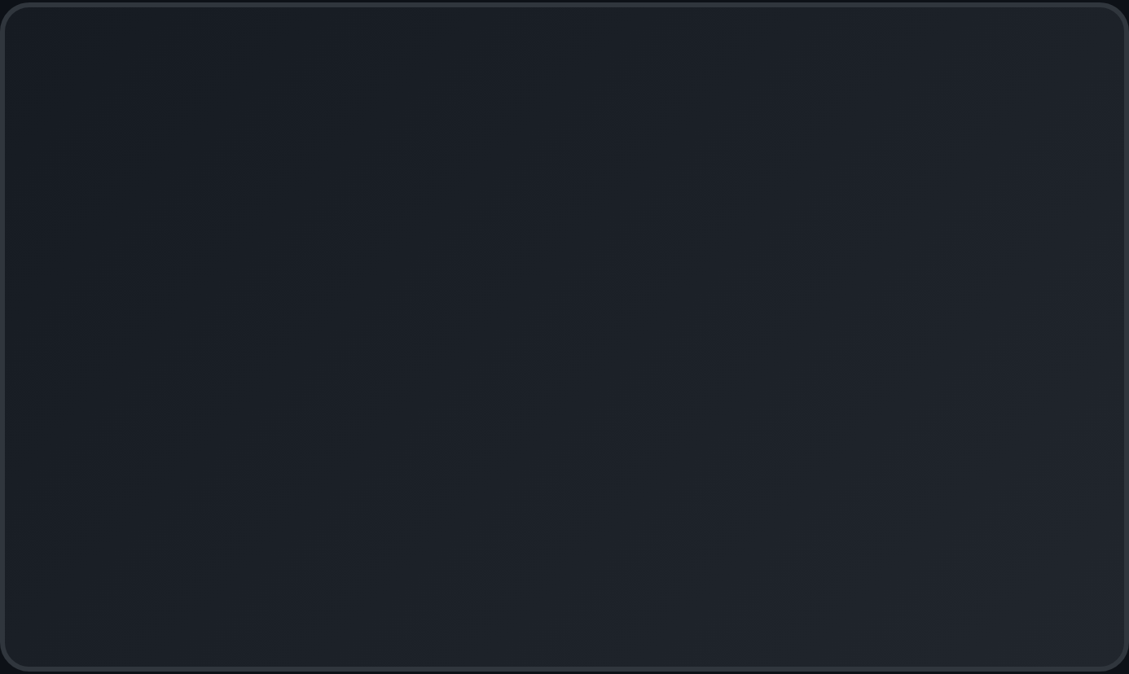
The Traditional Networking Mindset
THE TRAP
Network engineers come to Azure with decades of physical networking knowledge - and it betrays them.
"
We think in terms of:
Azure networking looks like traditional networking, but it's fundamentally different under the hood.
Switches and routers
VLANs and broadcast domains
ARP tables and MAC learning
Spanning tree and routing protocols
Physical cables and port channels
This mismatch causes design failures, troubleshooting nightmares, and security gaps.

Slide 6

SECTION 1
The Foundation: Azure SDN Architecture
Azure's networking is built on Software Defined Networking (SDN) running on Hyper-V hosts. The key components:
DEPLOYED SCALE
Virtual Filtering Platform (VFP) - The programmable vSwitch
1M+
Network Controller - Central policy management
hosts running VFP
VXLAN Encapsulation - Overlay networking
Scaling from 1 Gbps to 200 Gbps per host with SmartNIC offloads
Host Agent - Programs VFP with policies
Source: Microsoft Research - VFP NSDI 2017

Slide 7
Virtual Filtering Platform (VFP) Architecture
VFP - Hyper-V vSwitch Extension
Layer 1: ACL/Firewall Rules (NSGs)
GUEST VM
vNIC
Layer 2: NAT / Load Balancing
Layer 3: Metering / QoS
PHYSICAL
NIC / SmartNIC
Layer 4: VXLAN Encapsulation
Match-Action Flow Engine with Connection Tracking
Inbound: Layers processed top → bottom
Outbound: Layers processed bottom → top

Slide 8


MYTH #1
"Virtual Networks are like Physical Networks"
The VNet abstraction hides a completely different reality

Slide 9
The Truth: Azure VNets Are a Venn Diagram
WHAT YOU THINK
A VNet is a virtualized switch/router that traffic flows through
Peering = Merged Sets
VNet 1
VNet 2
WHAT'S ACTUALLY TRUE
A VNet is metadata that instructs the fabric which NICs can route to each other. There is no "network" - just policy.
Creating a VNet tells Azure: "These NICs belong to the same routing domain." The physical network has no knowledge of your VNet structure.
Peering doesn't create a "pipe" - it just expands which NICs can reach each other

Slide 10
How Packets Actually Travel: VXLAN Encapsulation
Customer packets are wrapped in VXLAN headers and sent over Microsoft's physical network. Your "Layer 2" traffic is actually Layer 3+.
Original Customer Packet:
Customer
Ethernet
Customer
IP
Payload
After VXLAN Encapsulation:
Outer
Ethernet
Outer IP
(Host PA)
UDP
4789
VXLAN
VNI
Inner
Eth
Inner
IP
Payload
MTU Impact
VNI = 24-bit
Internal Azure MTU is 1400 (not 1500) due to encapsulation overhead
~16 million virtual networks vs. 4,096 VLANs
Notes:
What is VXLAN?
Virtual Extensible LAN (VXLAN) is a network virtualization protocol designed to address the scalability challenges associated with large cloud-based environments. By using an encapsulation technique, VXLAN allows Layer 2 Ethernet frames to be transmitted over Layer 3 (IP) networks, enabling the creation of virtualized Layer 2 networks on top of existing Layer 3 infrastructures.
The Origins of VXLAN
VXLAN was initially developed by VMware, Arista Networks, and Cisco in 2011. It was created to overcome the limitations of traditional VLANs, which have a maximum of 4,096 unique identifiers (VLAN IDs). With the growing demand for cloud-based solutions, there was a pressing need for a more scalable approach to network virtualization. VXLAN addressed this need by extending the number of available network identifiers to 16 million, allowing for the creation of far more extensive virtual networks.
How Does VXLAN Work?
VXLAN encapsulates Ethernet frames in a UDP (User Datagram Protocol) packet, enabling them to traverse Layer 3 networks. The encapsulation process involves adding a VXLAN header and an outer IP header to the original Ethernet frame. The VXLAN header contains a 24-bit Virtual Network Identifier (VNI), which uniquely identifies the virtual Layer 2 network segment.
The VXLAN process involves two main components: VXLAN Tunnel Endpoints (VTEPs) and VXLAN gateways. VTEPs are responsible for encapsulating and de-encapsulating Ethernet frames, while VXLAN gateways provide connectivity between VXLAN and non-VXLAN networks.
VTEPs encapsulate Ethernet frames from a specific virtual network and send them through a Layer 3 infrastructure to the destination VTEP, which then de-encapsulates the packet and forwards it to the destination virtual network. VXLAN gateways allow VXLAN-based networks to communicate with traditional VLAN-based networks or physical servers, enabling seamless communication across different network types.
Why Did Microsoft Choose VXLAN for Azure?
Microsoft likely opted for VXLAN in their Azure cloud solutions for several reasons:
Scalability: As mentioned earlier, VXLAN offers superior scalability compared to traditional VLANs. This is critical in cloud environments, where thousands of virtual networks may need to coexist and communicate.
Flexibility: VXLAN's ability to transmit Layer 2 Ethernet frames over Layer 3 networks enables the creation of flexible, virtualized networks. This feature allows organizations to adapt their network infrastructures as they grow and change.
Interoperability: VXLAN is a widely adopted industry standard, ensuring compatibility with a broad range of networking equipment and cloud solutions. This interoperability simplifies the integration of Azure services with existing network infrastructures.
Improved Traffic Isolation: VXLAN provides better traffic isolation between virtual networks, reducing the likelihood of interference or security breaches.
Simplified Management: By using VXLAN in conjunction with software-defined networking (SDN) technologies, Azure can provide simplified network management, allowing organizations to focus on their core business processes rather than network maintenance.

Slide 11
MYTH #2
"Subnets are Broadcast Domains"
No broadcast. No multicast. No L2 switching.

Slide 12
What Azure VNets Block by Design
BLOCKED TRAFFIC TYPES
REAL-WORLD IMPACT
No VRRP/HSRP for HA - use Azure Load Balancer
No Windows Clustering heartbeats via multicast
No SQL Server AG multicast listeners
No traditional NLB in multicast mode
✗
Multicast - No IGMP, no multicast routing
✗
Broadcast - L2 and L3 broadcasts blocked
✗
GRE packets - Generic Routing Encapsulation
✗
IP-in-IP - Encapsulated packets
✗
DHCP unicast - Ports UDP/67-68 intercepted
WHAT DOES WORK
Unicast IPv4/IPv6, TCP, UDP, ICMP (for testing)
Notes:
Virtual Router Redundancy Protocol
VRRP (Virtual Router Redundancy Protocol) is a networking protocol that provides automatic assignment of available IP routers to participating hosts, enhancing the availability and reliability of routing paths. It allows multiple routers to share a virtual IP address, creating a redundant virtual gateway that ensures continuous communication services even if one router fails. VRRP operates by designating one router as the master and others as backups, which take over if the master becomes unavailable. This protocol is widely used in various networking environments to improve fault tolerance and network reliability.
Hot Standby Router Protocol (HSRP) is a Cisco proprietary redundancy protocol for establishing a fault-tolerant default gateway.
Generic Routing Encapsulation (GRE) is a tunneling protocol developed by Cisco that allows for the encapsulation of various network layer protocols within a point-to-point link over an IP network. It is primarily used to create virtual point-to-point connections

Slide 13
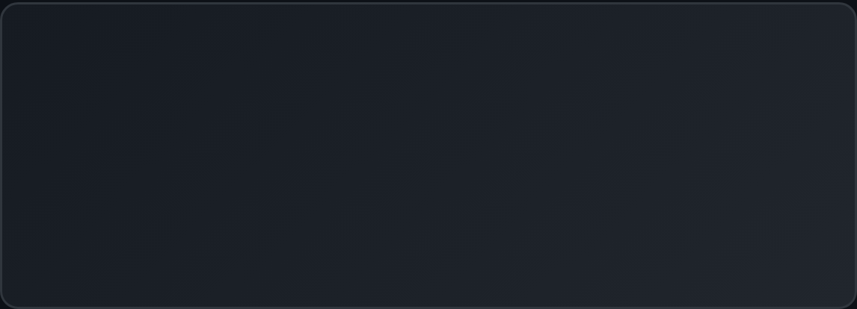
Subnets = Routing Policy Containers
An Azure subnet is not a Layer 2 broadcast domain. It's a logical grouping of NICs that share the same:
DESIGN IMPLICATION
Put resources that need different routing or security policies in different subnets - not based on "network segments".
1
Routing policy (Route Tables / UDRs)
2
Security policy (NSGs at subnet level)
3
Service Endpoints (PaaS connectivity)
⚠ COMMON MISTAKE
Creating "DMZ" subnets thinking they provide L2 isolation. There's no L2 in Azure - only policy enforced at the NIC.
4
Delegations (Azure service integrations)

Slide 14
MYTH #3
"ARP and DHCP Work Like Normal"
The fabric intercepts and synthesizes responses

Slide 15
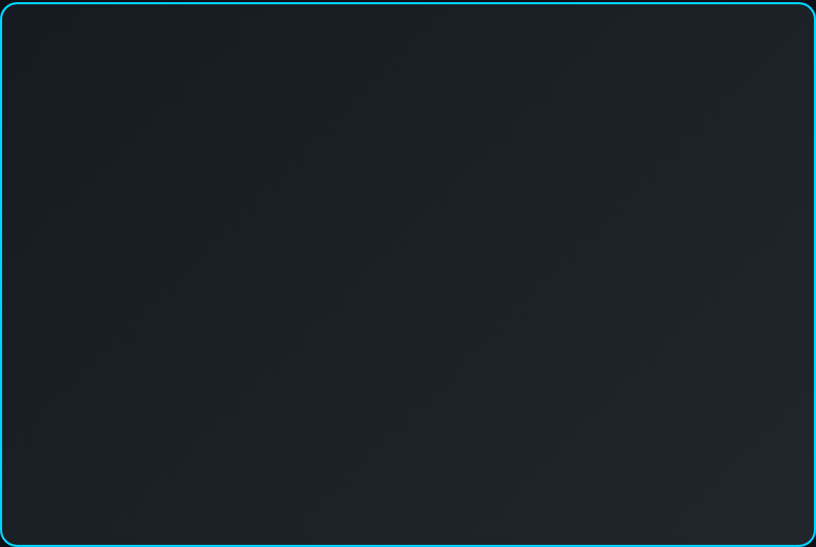
ARP in Azure: It's All a Lie
ARP requests in Azure don't reach other VMs. The VFP intercepts them and synthesizes responses.
HOW IT ACTUALLY WORKS
VM sends ARP request
VFP intercepts at vSwitch
Network Controller lookups destination
VFP injects synthetic ARP response
Packet forwarded based on IP routing policy
$ arp -a (from any Azure VM)
10.0.0.1 12:34:56:78:9a:bc
10.0.0.5 12:34:56:78:9a:bc
10.0.0.10 12:34:56:78:9a:bc
Every host returns the same MAC!
The synthetic MAC 12:34:56:78:9a:bc is the Azure Virtual Router. All traffic goes to this "router" which forwards based on IP, not MAC.
IMPLICATION: MAC addresses are meaningless in Azure. Don't design around them.
Notes:
Networking in Microsoft Azure – Part I – Untangled

Slide 16
DHCP: Controlled by the Fabric
DHCP in Azure is provided by the host, not a DHCP server you deploy. The IP address is determined by your Azure configuration.
RESERVED UDP PORTS
⚠ NEVER DO THIS
Disable DHCP on VM NICs
Manually assign static IPs inside the guest OS
Run your own DHCP server for Azure VMs
67
68
4789
DHCP Server
DHCP Client
VXLAN
Host services available via 168.63.129.16: DHCP, DNS, health probes, IMDS
CORRECT APPROACH
Set "static" IPs in Azure portal/ARM - DHCP still delivers them, but they don't change.

Slide 17
MYTH #4
"Routing Works Like On-Premises"
No recursive lookups. Routing happens at the NIC.

Slide 18
Routing Happens at the NIC, Not a Router
Azure NICs have three built-in capabilities. There is no central router - each NIC makes its own routing decisions.
NO RECURSIVE ROUTING
Unlike physical routers, Azure doesn't do recursive lookups. If the next-hop isn't directly reachable, the route fails.
Routing
Effective routes determine where packets go
Effective routes example:
Filtering
10.0.0.0/16 → VirtualNetwork
NSGs enforced at the NIC level
0.0.0.0/0 → Internet
10.1.0.0/16 → VNetPeering
NAT
Check effective routes on any NIC in the portal under "Effective routes" to see what Azure will actually do.
Public IP translation at the NIC

Slide 19
Route Selection: The Priority Order
PRIORITY ORDER (highest first)
⚠ EXCEPTION: Service Traffic
1
User-Defined Routes (UDRs)
System routes for VNet peering, Service Endpoints, and VNet service traffic always win over BGP routes - even with longer prefix match.
Your custom routes in Route Tables
2
BGP Routes
From VPN Gateway / ExpressRoute
LONGEST PREFIX MATCH
Within the same priority tier, the most specific route (longest prefix) wins.
3
System Routes
10.0.1.0/24 beats 10.0.0.0/16
Azure's automatic routes for VNet, Internet

Slide 20
MYTH #5
"NSGs are Simple Stateless ACLs"
Did you know they’re actually statefull?!

Slide 21
NSGs Are Stateful Firewalls
Unlike AWS NACLs, Azure NSGs track connection state. Return traffic is automatically allowed.
NSG PROCESSING ORDER
INBOUND TRAFFIC
EXAMPLE: Web Server on Port 443
Subnet NSG → NIC NSG
Both must allow for traffic to pass
✓
Allow inbound TCP/443 from Internet
⊘
No outbound rule needed for responses
The flow record tracks the connection and auto-permits return traffic.
OUTBOUND TRAFFIC
NIC NSG → Subnet NSG
Order is reversed from inbound
GOTCHA: Existing Connections
Adding a deny rule doesn't kill existing flows. New connections blocked, old ones continue until timeout.
Best practice: Use subnet-level NSGs for shared policy, NIC-level for specific overrides.
Notes:
A flow record is created for existing connections.
Communication is allowed or denied based on the connection state of the flow record. The flow record allows a network security group to be stateful. If you specify an outbound security rule to any address over port 80, for example, it's not necessary to specify an inbound security rule for the response to the outbound traffic. You only need to specify an inbound security rule if communication is initiated externally. The opposite is true. If inbound traffic is allowed over a port, it's not necessary to specify an outbound security rule to respond to traffic over the port.
When you remove a security rule that allowed a connection, existing connections remain uninterrupted. Network security group rules only affect new connections. New or updated rules in a network security group apply exclusively to new connections, leaving existing connections unaffected by the changes. For example, if you have an active SSH session to a virtual machine and then remove the security rule allowing that SSH traffic, your current SSH session remains connected and functional. However, if you try to establish a new SSH connection after the security rule removal, that new connection attempt will be blocked.
Azure network security groups overview | Microsoft Learn

Slide 22
Where NSGs Actually Execute
NSG rules are programmed into the VFP layer of the Hyper-V vSwitch on each host. They're not running in a separate appliance.
VM / Guest OS
5-Tuple Matching
Source IP, Source Port, Dest IP, Dest Port, Protocol
VFP - NSG Rules Layer
5-tuple matching + connection tracking
Connection State Tracking
Flow records persist for 4+ minutes by default
Hyper-V vSwitch
No Performance Penalty
Hardware offload via SmartNICs when using Accelerated Networking

Slide 23

DEEP DIVE
The Virtual Filtering Platform
Established: September 1, 2011

Slide 24
VFP: A Match-Action Flow Engine
VFP processes packets through a series of Layers, each containing Groups of Rules.
VFP OBJECT HIERARCHY
Port (vNIC)
└─ Layer (ACL, NAT, Encap...)
PROCESSING MODEL
└─ Group (Rule container)
1
Match - Classify packet against rules
└─ Rule (Match + Action)
2
Action - Transform, forward, or drop
3
Cache - Create Unified Flow for fast path
KEY INSIGHT
First packet takes the slow path (full rule evaluation). Subsequent packets in the same flow hit the cached Unified Flow - microsecond latency.
Inbound and outbound packets traverse layers in opposite order. This creates symmetric policy enforcement without duplicate rules.
Source: Microsoft Research - VFP NSDI 2017
Notes:
VFP: A Virtual Switch Platform for Host SDN in the Public Cloud (Article version) - Microsoft Research

Slide 25
Control Plane: How Policy Reaches VFP
Policy is declarative - you define intent, controller figures out rules
Azure Portal / ARM
VFP supports live migration - port state serialized to new host
Network Controller
RESTful Northbound API
Host Agent
OVSDB Southbound
VFP on Hyper-V Host
ACLs
NAT
VXLAN

Slide 26
PERFORMANCE
Accelerated Networking & SR-IOV
Team Rocket blast off at the speed of light!

Slide 27
SR-IOV: Bypassing the Host
Single Root I/O Virtualization (SR-IOV) allows VMs to talk directly to the physical NIC, bypassing the host's vSwitch.
WITH ACCELERATED NETWORKING
VM (VF Driver)
WITHOUT ACCELERATED NETWORKING
↓ Direct path
VM
SmartNIC (Policy in HW)
↓
NSGs/ACLs offloaded to hardware
Host vSwitch + VFP
↓
< 25μs
30M+
~0%
Physical NIC
Latency
PPS
CPU overhead

Slide 28
Azure SmartNICs: The Secret Weapon
Azure uses FPGA-based SmartNICs to offload VFP policies to hardware. This isn't just SR-IOV - it's programmable hardware acceleration.
Mellanox ConnectX NICs with FPGA offload
WHAT GETS OFFLOADED
✓
NSG / ACL rules
VFP Unified Flows compiled to hardware tables
✓
VXLAN encap/decap
✓
NAT / Load balancer hairpin
Full policy enforcement in NIC - not just fast path
✓
Connection tracking
✓
QoS metering
FAILSAFE DESIGN
If VF fails, traffic automatically falls back to synthetic NIC through host vSwitch. No connectivity loss.

Slide 29
THE DEEPER TRUTH
Packets Don't Traverse Networks—
They Get Dropped Into Memory
How Azure’s architecture makes networking an illusion

Slide 30
"Wormhole" Networking: Source to Destination
WHAT YOU EXPECT
VM → Virtual Switch → Virtual Network → Subnet → Default Gateway → Routing → Destination NIC
WHAT ACTUALLY HAPPENS
Packet leaves source NIC → appears directly at destination NIC. No hops, no routers, no gateways.
SOURCE VM
DIRECT MEMORY COPY
DEST VM
10.0.1.10
10.0.2.20
NIC
NIC
"Wormhole area networking is the best way of describing it. Packet went in, came out the other end."
Gateway? Router? Switch?
✕
This is why traceroute is pointless in Azure and why the default gateway doesn't respond to ping.

Slide 31
The Real Packet Journey: Encapsulation & Memory
STEP 1
→
STEP 2
→
STEP 3 (VFP)
→
STEP 4
→
STEP 5 (VFP)
→
STEP 6
Guest OS sends packet
Hits Azure NIC / vSwitch
Encapsulated w/ VXLAN
Physical network
Decapsulated
Dropped into dest NIC
SAME HOST = NO NETWORK
DIFFERENT HOST = TUNNEL
If source and destination VMs are on the same Hyper-V host, the packet never touches the physical network. It's a pure memory-to-memory copy via the vSwitch.
When hosts differ, the packet is encapsulated with physical addresses (PA) and tunneled. The customer address (CA) is hidden from the physical network.
"The packet reaches the source NIC, hits the virtual switch and is encapsulated. The physical network could be in the same rack, a neighboring data center, or somewhere around the world—but from our perspective, that doesn't matter. All we see is packets going directly from source to destination."
— Aidan Finn, D2DO273: Azure VNets Don't Exist
KEY INSIGHT: The "network" you design exists only as metadata. The physical layer is invisible to you.

Slide 32
Same-Host VMs: Pure Memory Copy
WHEN VMs SHARE A HOST
The Hyper-V vSwitch knows both VMs are local. It reads the destination MAC, finds the target vNIC in its table, and copies the packet directly to the destination VM's memory.
HYPER-V HOST
VM 1
VM 2
Guest Memory
Guest Memory
NO PHYSICAL NETWORK TRAVERSAL
vNIC
vNIC
No encapsulation needed
No VXLAN overhead
No physical NIC involvement
Sub-microsecond latency
vSwitch + VFP
MAC Learning • Policy • Memory Copy
direct
Physical NIC
Cross-host and external flows leverage encapsulation; same-host flows are direct via the vSwitch.
NOT USED
— Azure Local SDN Documentation
VFP still enforces ACLs, QoS, and monitoring… But the packet never leaves host memory. This is why VM placement can affect network performance.

Slide 33
What This Means for Your Architecture
BECAUSE PACKETS GO DIRECT...
YOU MUST DESIGN DIFFERENTLY...
Subnets ≠ Isolation
Use Smaller VNets
Different subnets in the same VNet route directly. Subnets don't segment—NSGs do.
One workload per VNet. Peer to hub. Traffic isolation via the hub firewall—not giant monolithic VNets.
No Default Gateway Hop
Routing = Your "Cabling"
The default gateway doesn't process traffic—it's a fiction for your OS. UDRs override direct routing.
On-prem cables force traffic paths. In Azure, UDRs force traffic through your firewall—that's your security model.
VNet Peering = Merged Sets
NSG = Your Segmentation
When you peer VNets, no cable is laid. The fabric just expands which NICs can reach each other directly.
Micro-segment with NSGs + ASGs. Block everything by default (custom deny-all rule), then allow only what's needed.
"There is no cabling in the fabric. Packets are encapsulated on the source host, transmitted over the physical network, decapsulated on the destination host, and presented to the destination VM's NIC. In short, packets leave the source NIC and magically appear on the destination NIC with no hops in between."
REMEMBER: If you're thinking in cables and switches, you're designing for a network that doesn't exist.

Slide 34
Wrapping it up
Is your brain fried? Mine sure is…

Slide 35
Design Implications: What This Means For You
STOP DOING
START DOING
Designing based on L2 broadcast domain assumptions
Design subnets around policy requirements, not "segments"
Expecting multicast/broadcast for clustering/HA
Use Azure Load Balancer for HA instead of VRRP/HSRP
Manually assigning IPs in guest OS
Enable Accelerated Networking on all supported VMs
Relying on MAC addresses for anything
Check effective routes when troubleshooting
Creating complex NSG outbound rules for allowed inbound
Use NSG flow logs for visibility into traffic patterns

Slide 36
Troubleshooting With This Knowledge
1. Check Effective Routes
Portal → NIC → Effective Routes. This shows what Azure actually does, not what you configured.
REMEMBER
2. Network Watcher Next Hop
Can't ping the default gateway (168.63.129.16 doesn't respond to ICMP) - this is by design, not a problem.
Test where traffic from a specific source would go. Accounts for UDRs, system routes, and BGP.
Useful commands:
3. NSG Flow Logs
arp -a
All MACs = 12:34:56:78:9a:bc
See exactly which NSG rule allowed/denied traffic. Records 5-tuple + decision.
route print (Windows)
Shows routes from guest perspective
4. IP Flow Verify
Test if NSGs would allow/deny a specific flow without sending real traffic.

Slide 37




Key Takeaways
1
VNets are policy, not infrastructure
They define which NICs can route to each other - there's no physical network construct.
2
There is no Layer 2 in Azure
No broadcast, no multicast, no real ARP. Everything is routed via VXLAN encapsulation.
3
VFP is the brain of Azure networking
All policies (NSGs, NAT, routing) are programmed into VFP layers on each host's vSwitch.
4
Accelerated Networking is a game-changer
SR-IOV + SmartNICs deliver near-bare-metal performance with full policy enforcement in hardware.

Slide 38
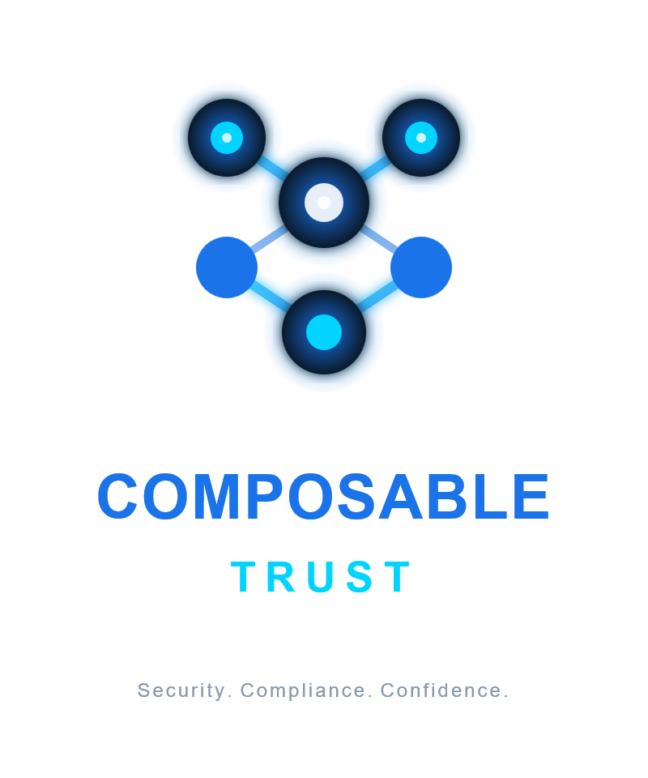
Coming soon…
Secure and compliant by design, not by manual effort

Slide 42

Resources & References
ESSENTIAL READING
VFP: A Virtual Switch Platform for Host SDN (NSDI 2017)
Azure Virtual Network FAQ - Microsoft Learn
Azure Accelerated Networking Overview
Hyper-V Network Virtualization Technical Details
Thank You!
Marc Dekeyser
Crimson Owl Technologies
NETWORK WATCHER TOOLS
Effective Routes - View computed routing tables
Next Hop - Test routing decisions
IP Flow Verify - Test NSG rules
NSG Flow Logs - Traffic analytics
Questions?

